Slide 1
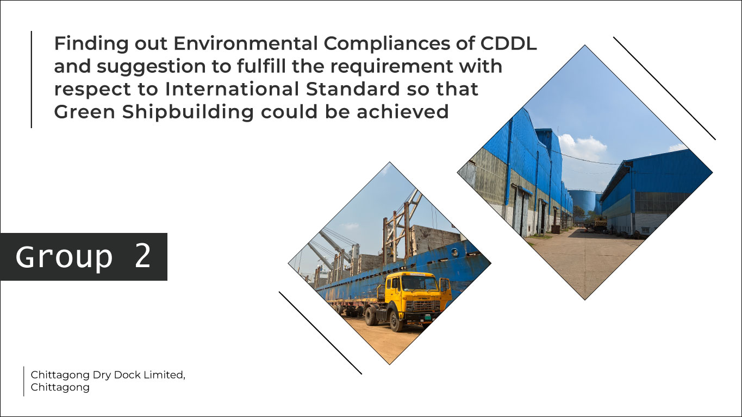

Slide 2

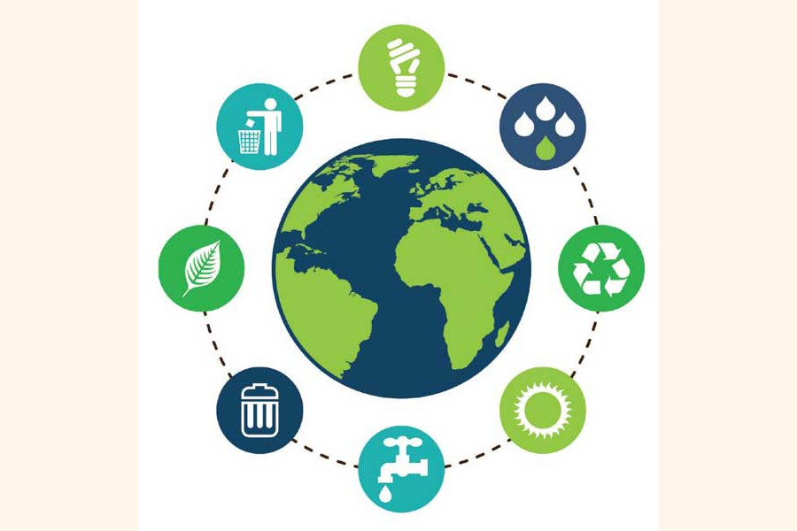
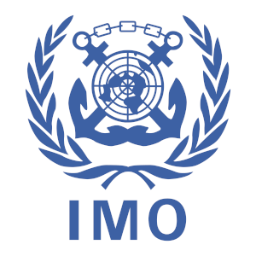
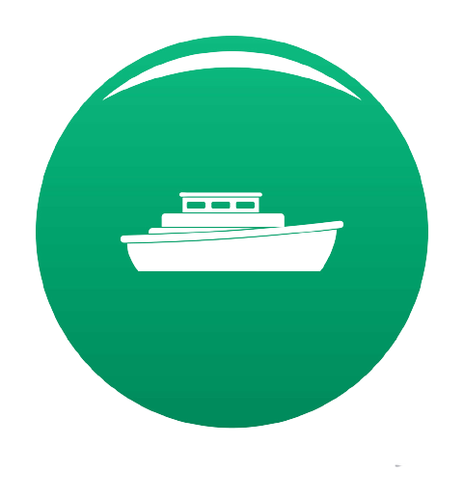
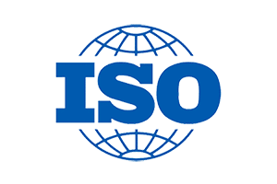
Introduction
Environmental compliance
International Standardization
Green Shipbuilding

Slide 3
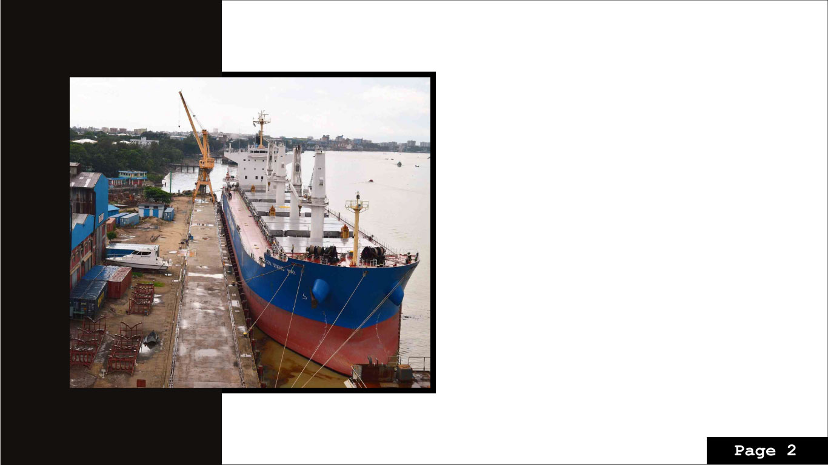
Present Condition at CDDL
Only dry dock in Bangladesh
Was constructed in 1967.
Currently, operated by Bangladesh Navy.

Slide 4

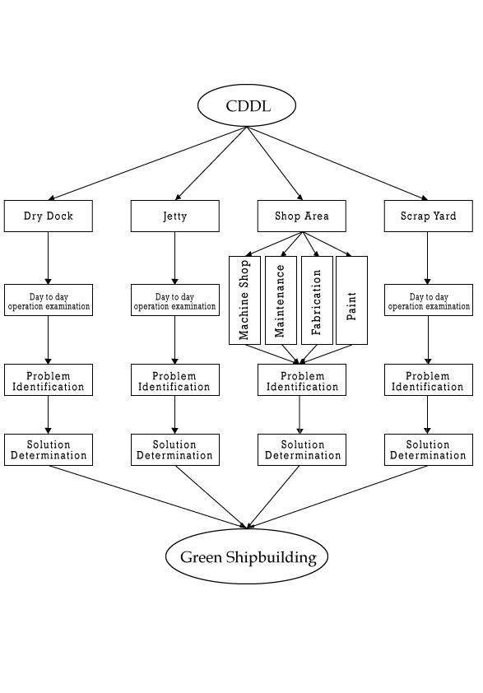
System Flowchart

Slide 5
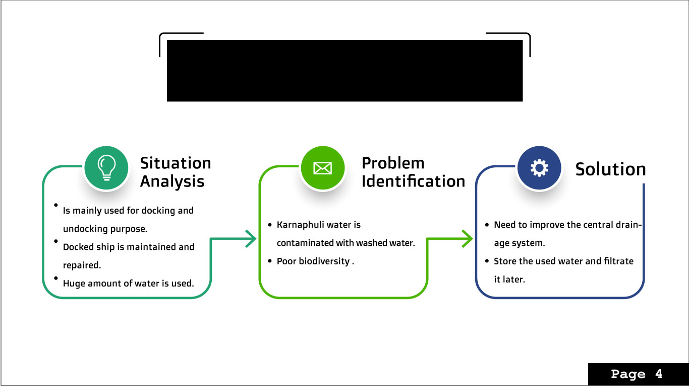
Dry Dock

Slide 6
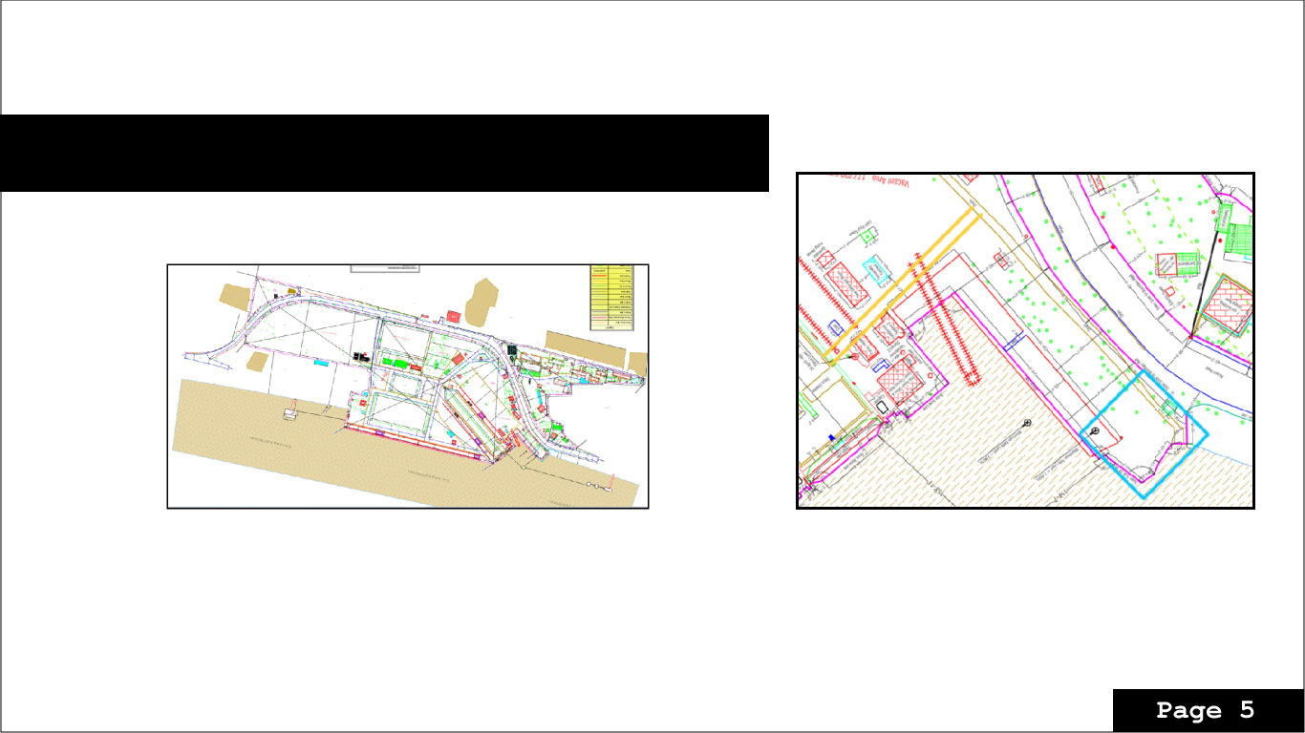
Improvised Layout for better drainage system

Slide 7

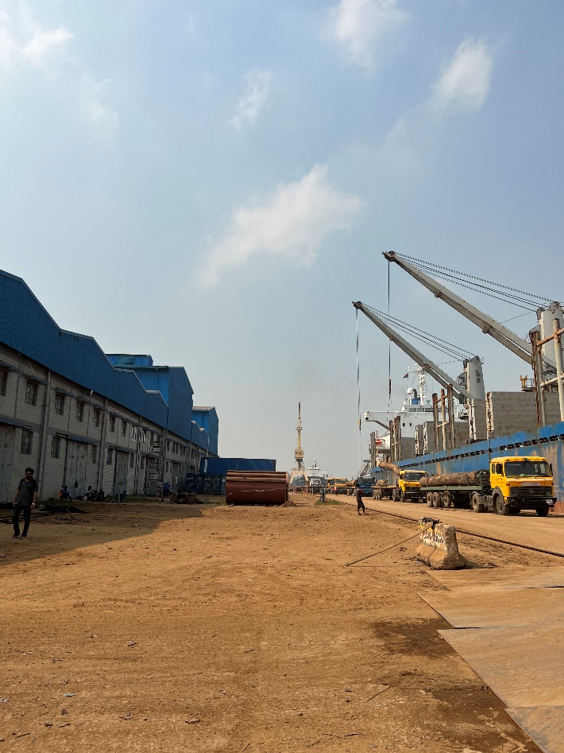
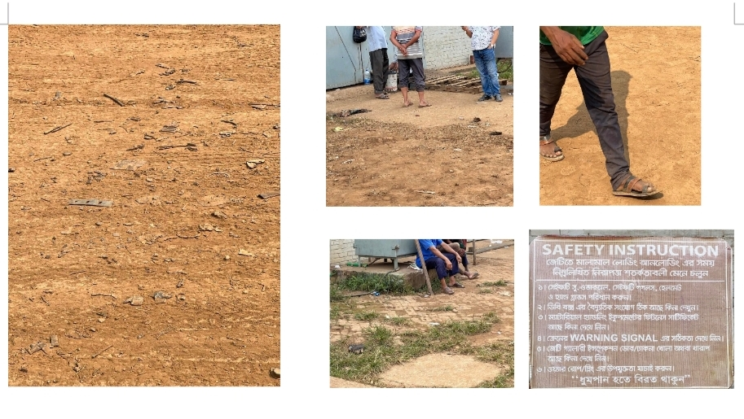
Jetty
Jetty
Primarily used for unloading wooden or steel industry raw materials.
Lack of following safety regulations
A huge blow of the dusts .
High temperature in machine shops

Slide 8
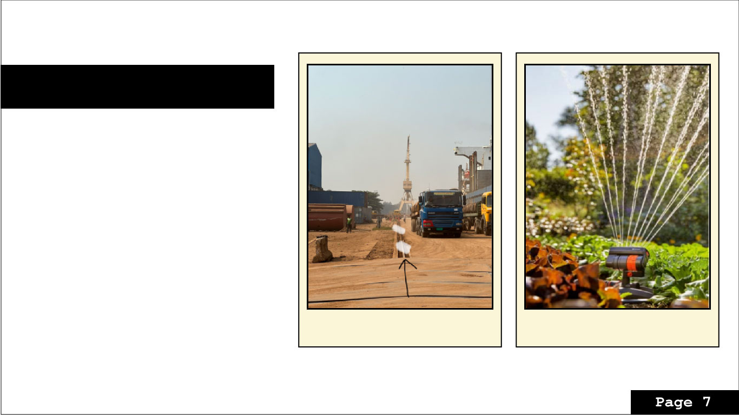
Solution:
Short term:
Find ways to reduce the amount of dust.
strict regulation about maintaining health
safety and regulations.
Apply sprinklers around the road .
It will cost 54 dollar each
And distance covered 2400 sq. feet
Sprinkler System
Alignment of the Sprinklers

Slide 9

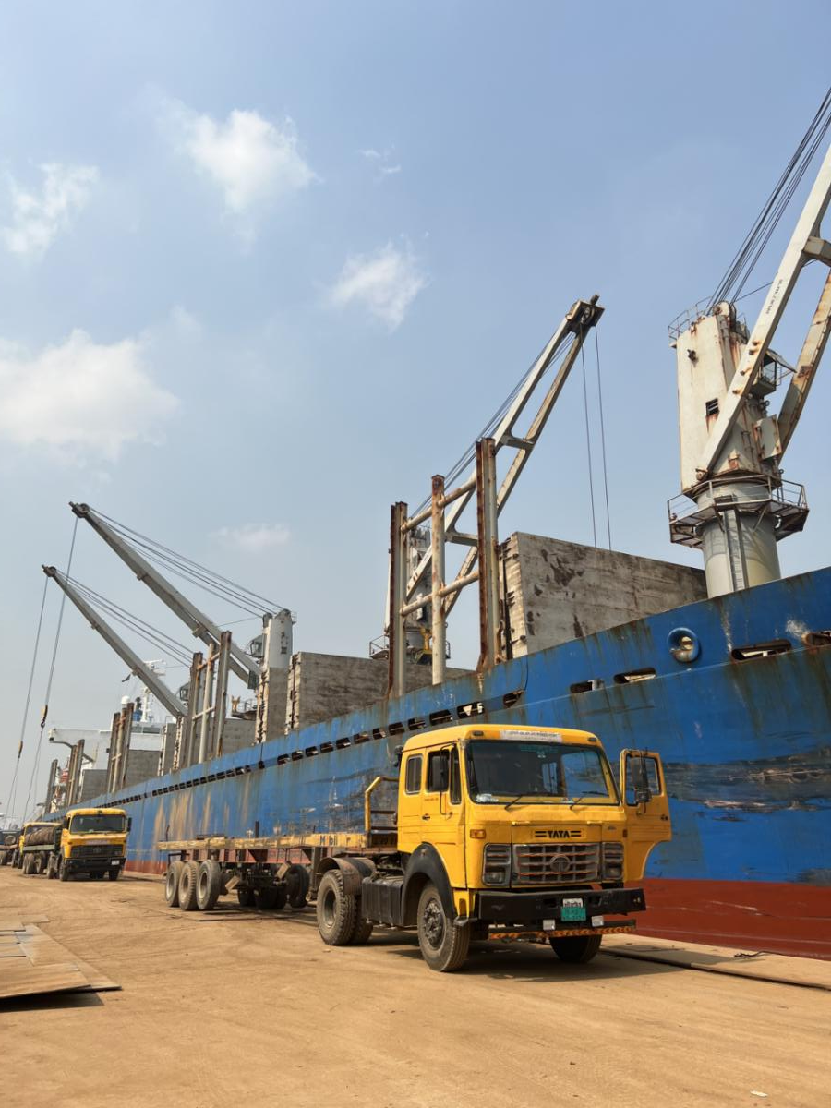
Long term:
Avoid the steel raw material unloading at jetty

Slide 10

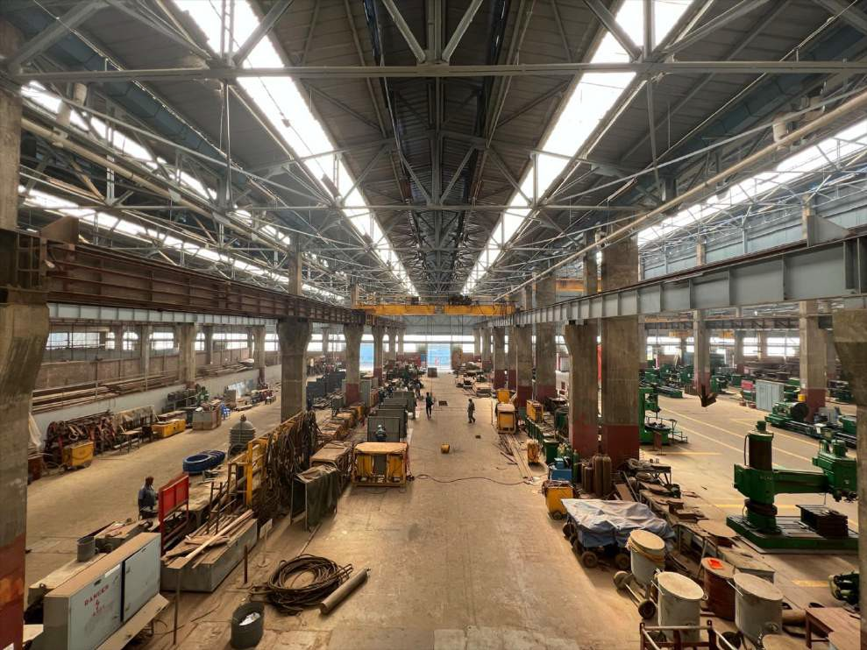
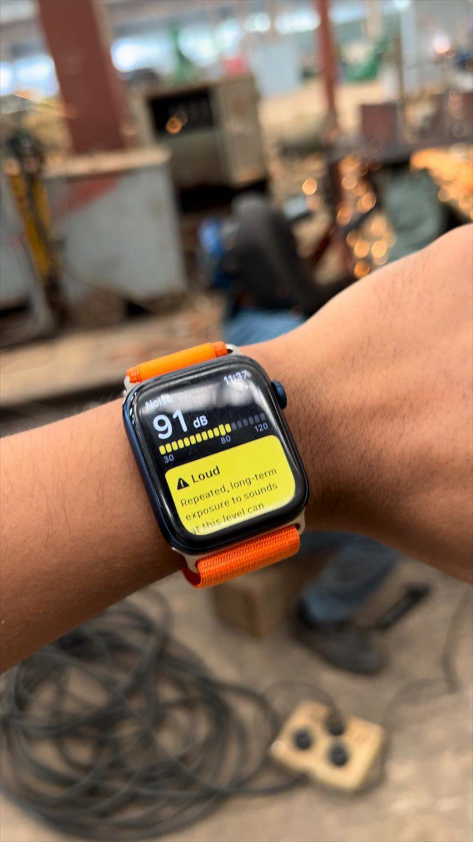
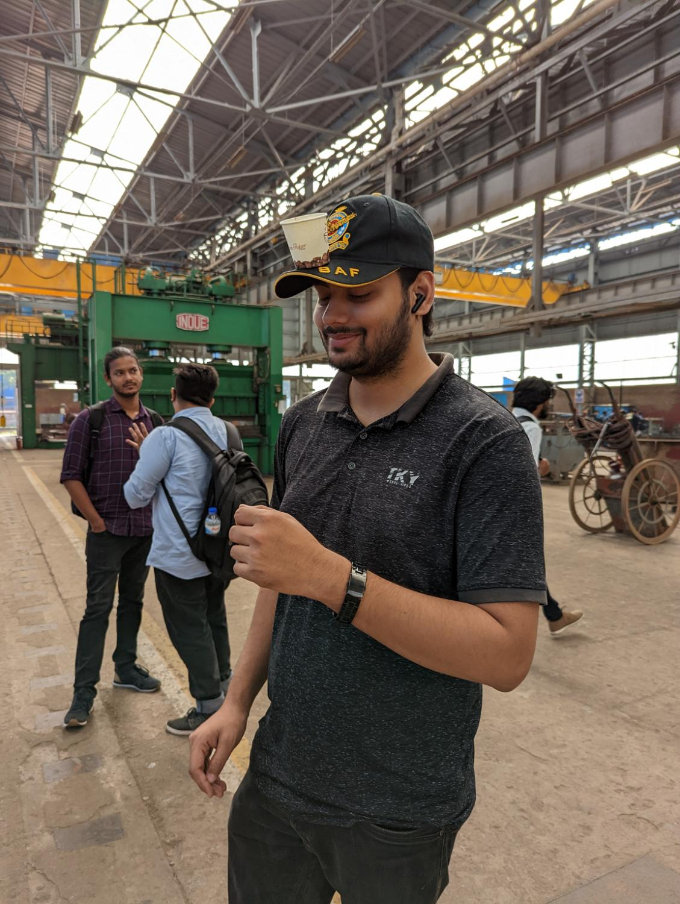
MACHINE SHOP AND FABRICATION SHOP
Lack of ventilation system has lead the total system to a huge temperature raise
While welding or using highly chaotic machineries workers are left working at sounds around 91 db.
Outdated machinery

Slide 11

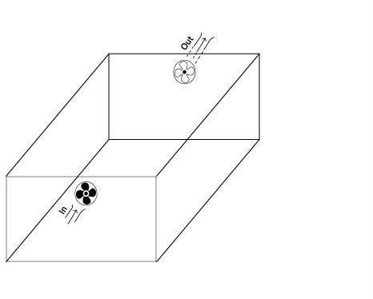
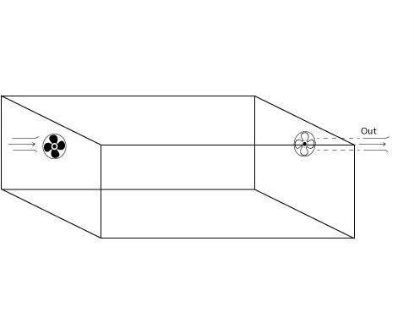
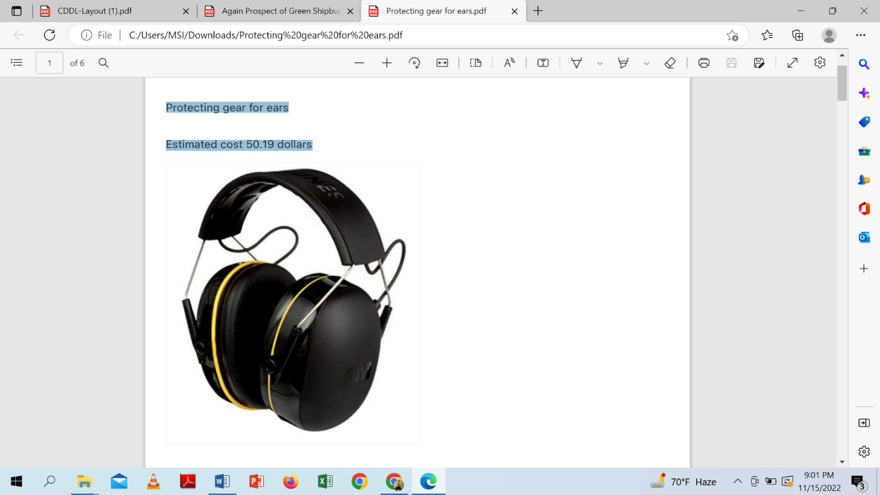
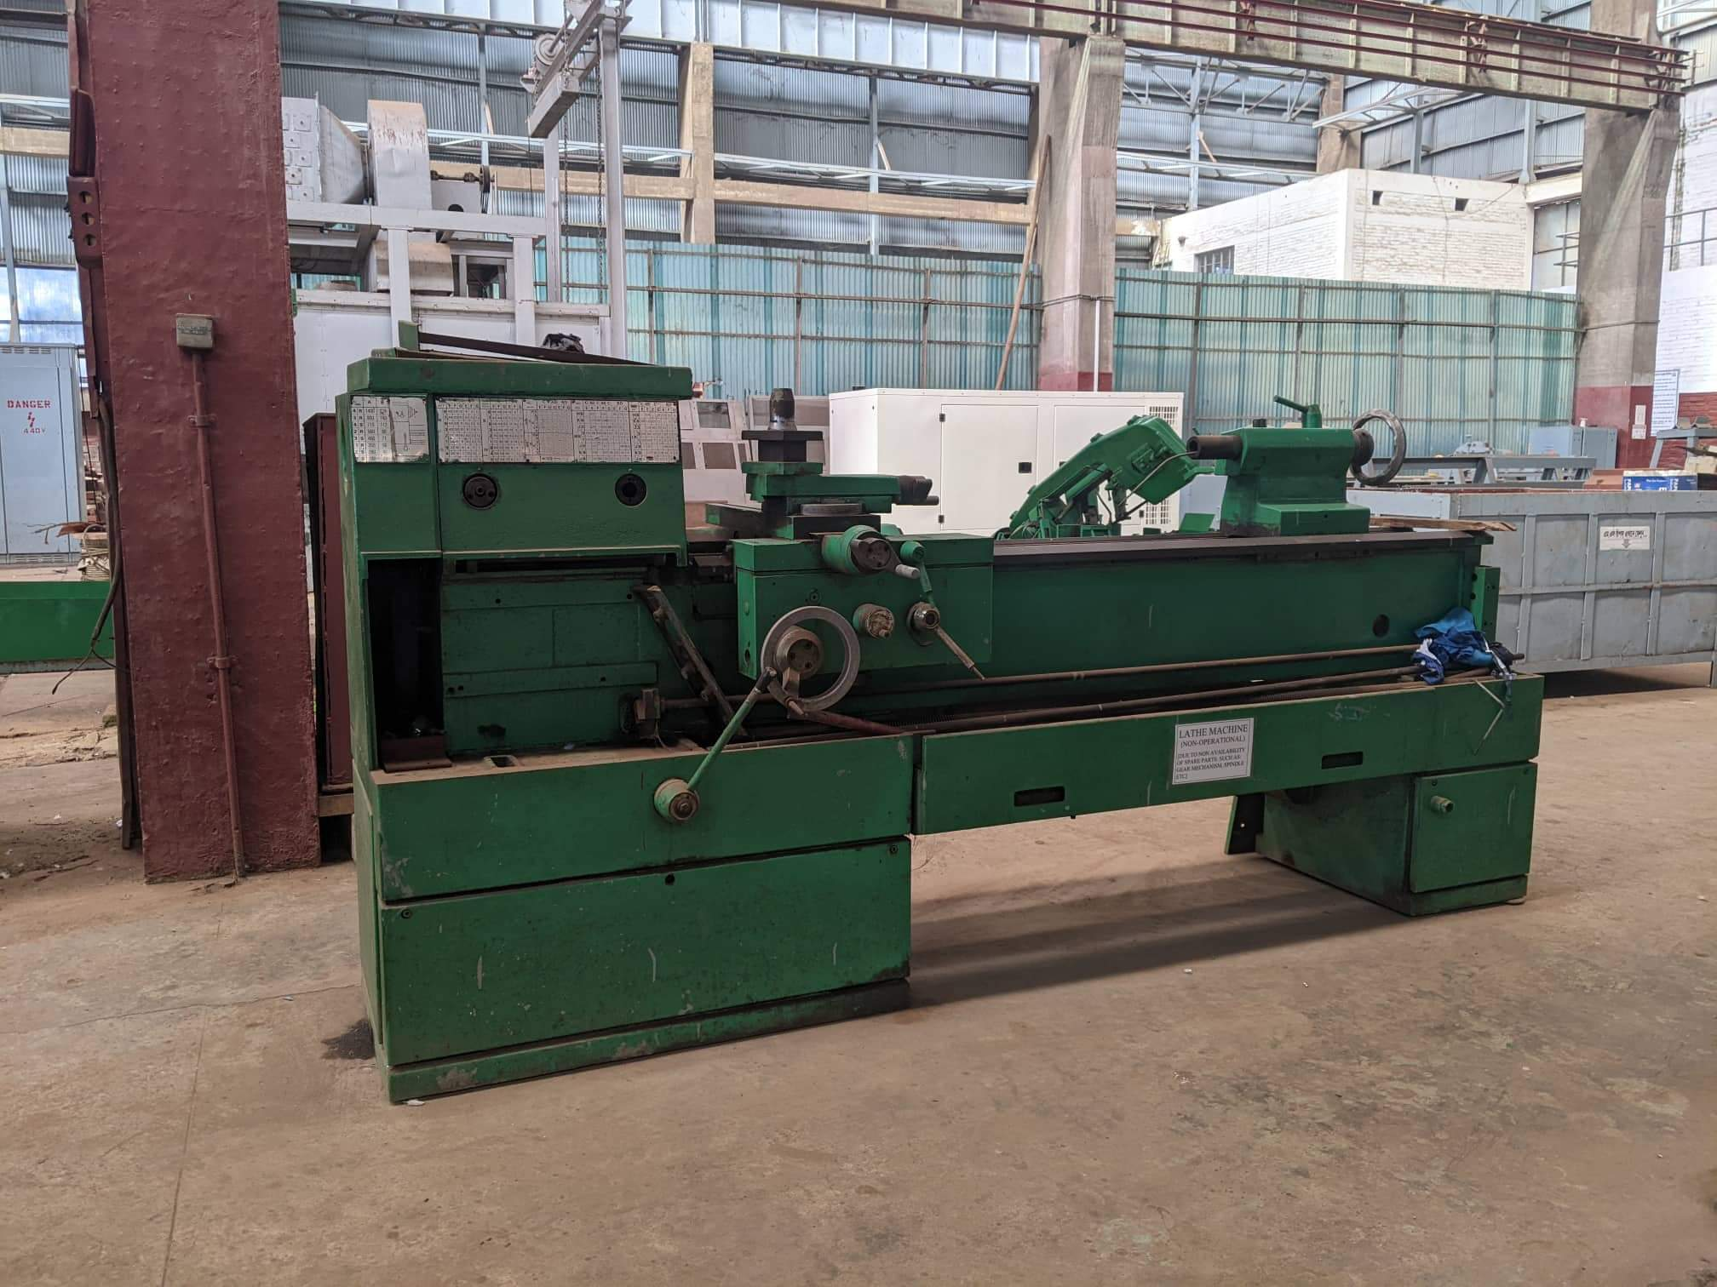
Figure: Exhaust fan transverse
Figure: Exhaust fan longitudinally
Introducing an exhaust fan ventilation system
Providing safety precautions for ears
Exchanging old machines

Slide 12

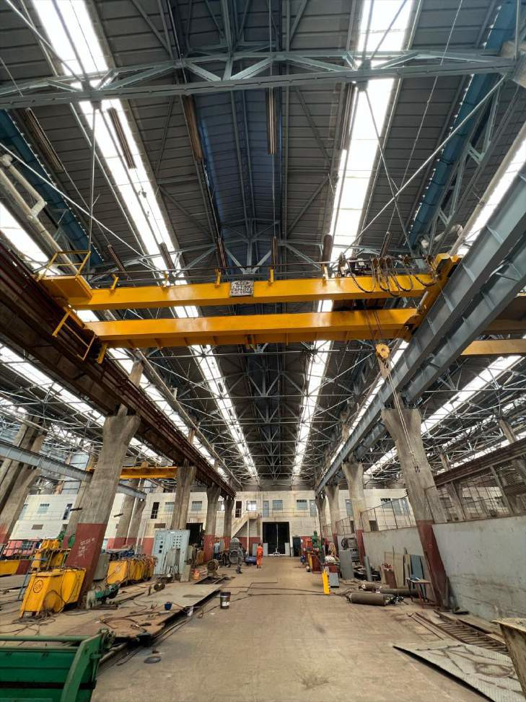
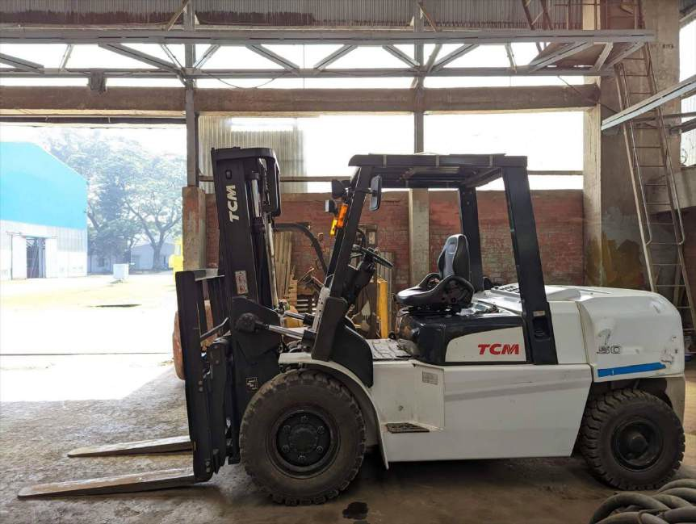
Maintenance shop
All the transports of CDDL are being repaired.
other machineries like over head crane
and forklift crane are also repaired.
Huge amount of carbon emission .
Washed grease and oil are directly going
to karnaphuly.
Replace heavy duty vehicles or
machineries.
Use “Oil and grease separator” properly.

Slide 13

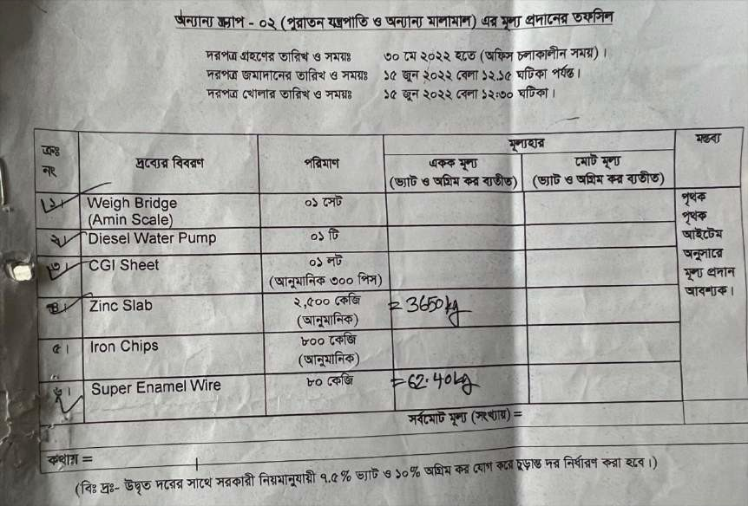
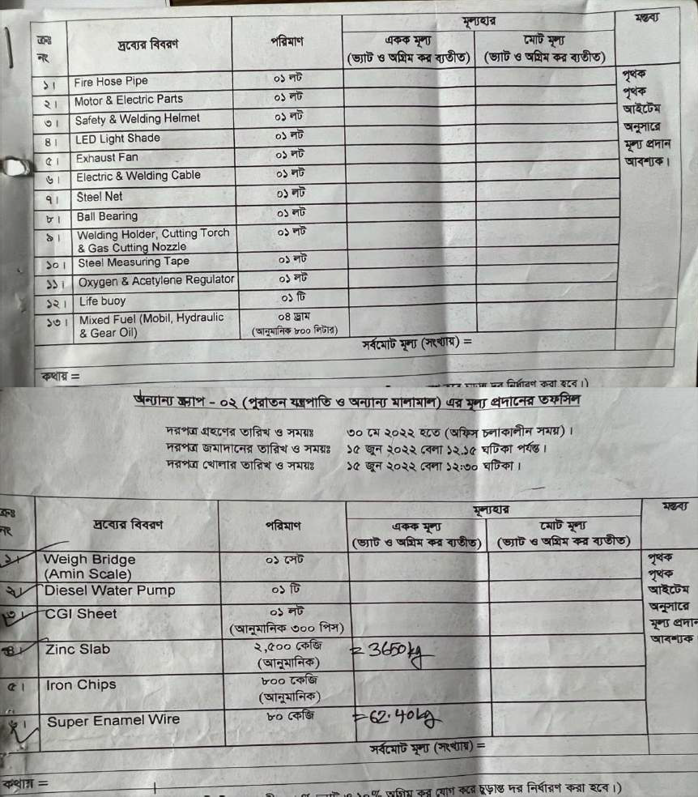
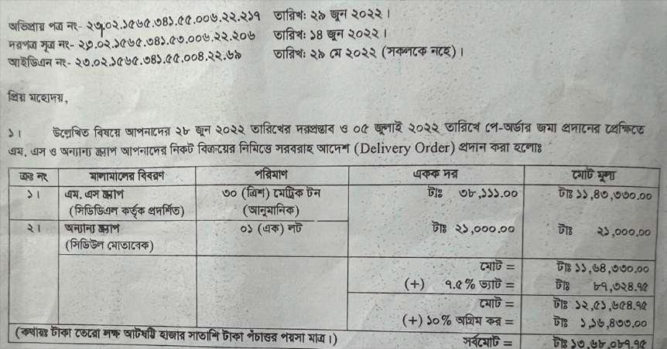
Scrap
separate section for storing scrap in Chittagong dry dock.
both plastic and metallic scraps present here
mild steel scraps are full of rust

Slide 14

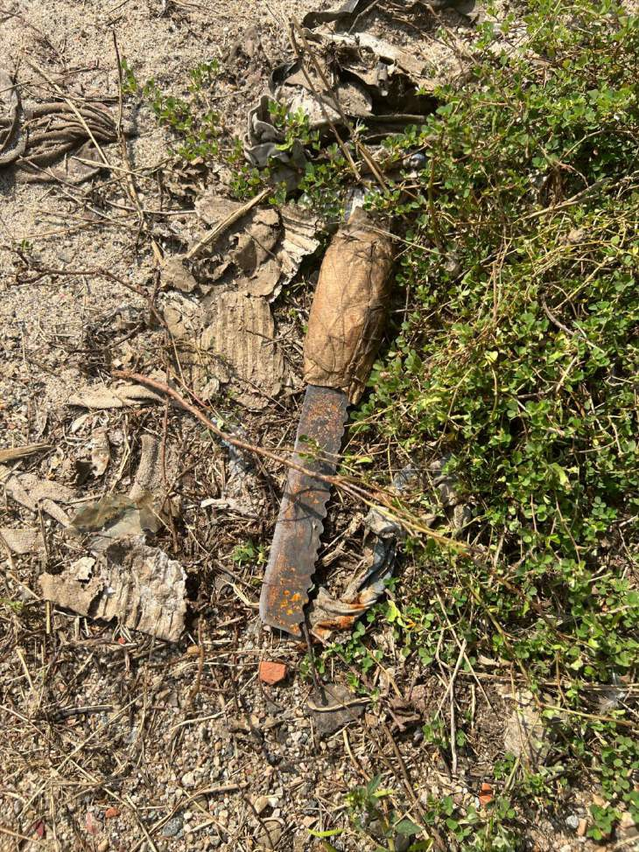
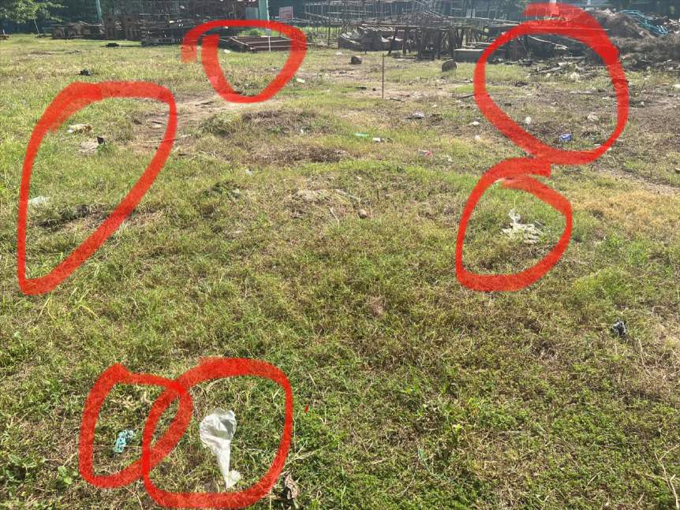
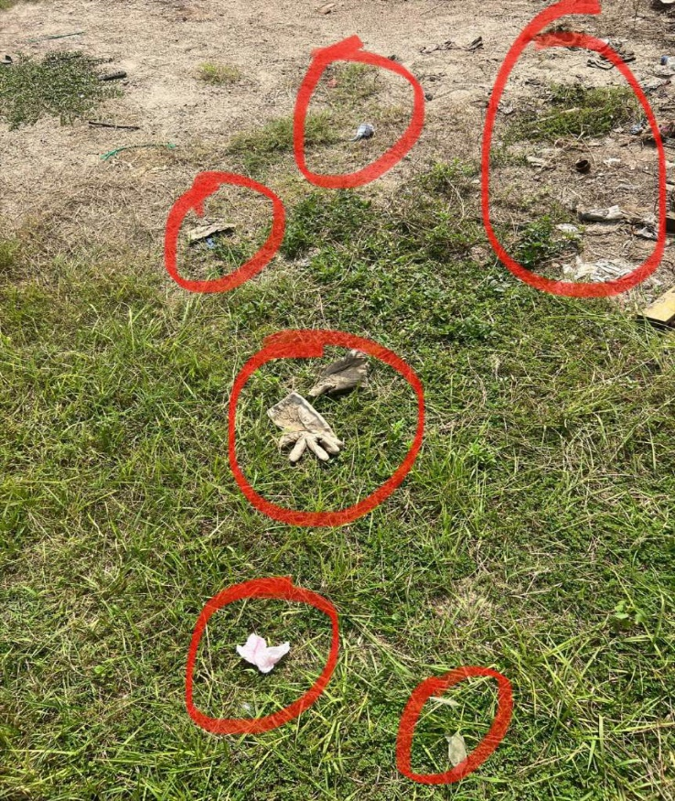
Bare rust filled
mild steel scraps
Plastic Scraps

Slide 15

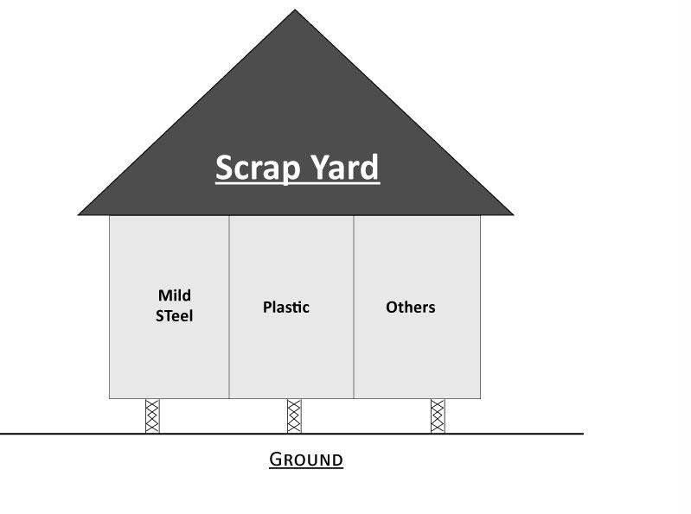
separate sections for plastic, MS and other scraps
will not get contaminated by the rust
Figure : New Solution for Scrap Yard

Slide 16
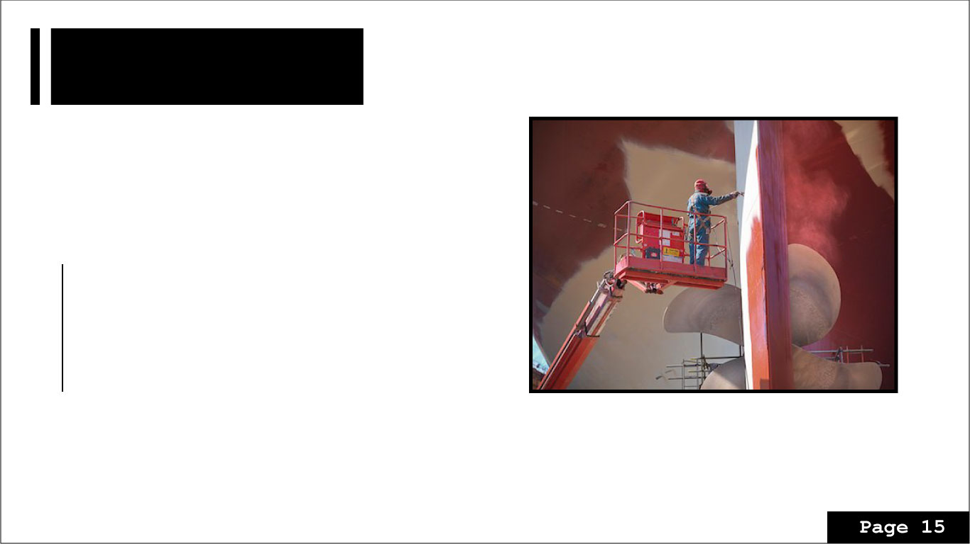
Painting
The quality of the number of protection gear used in painting is not up to the mark.
Solution:
Providing new and better-quality protection gear
Using anti-biocidal coatings
Increasing awareness of BIOFOULING and effect of painting
chemicals in river or sea.
Introducing wet blasting instead of hydroblasting.

Slide 17

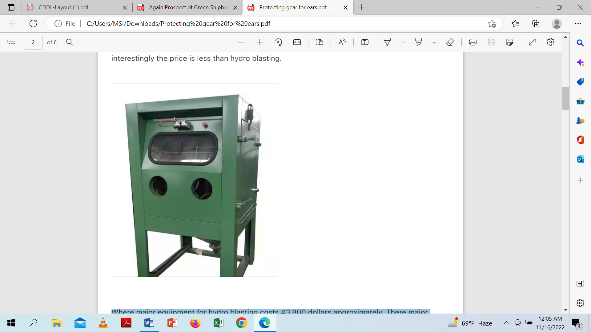
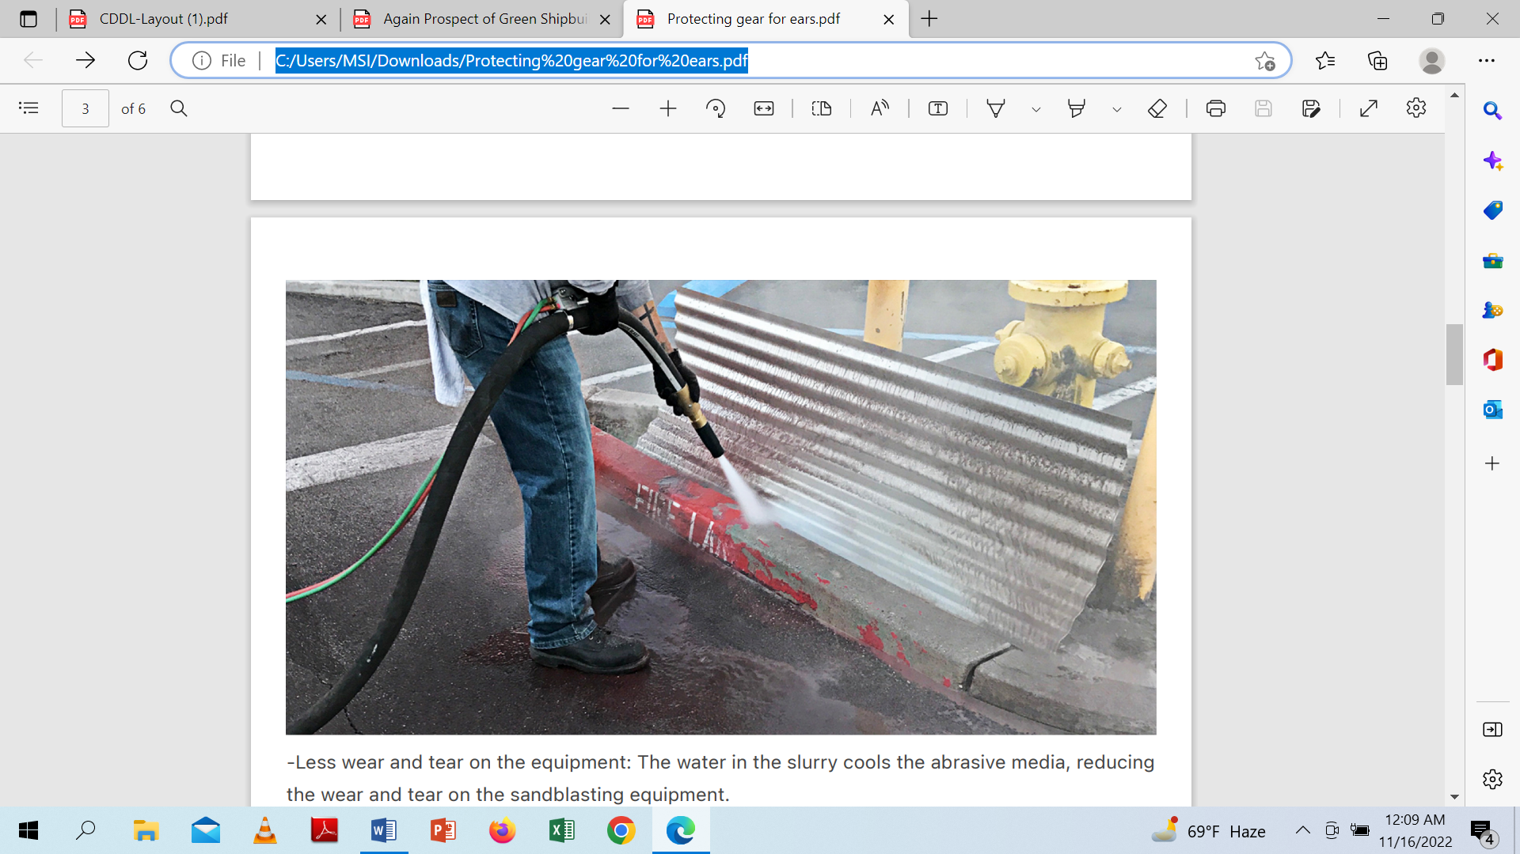
Figure : Wet Blasting Equipment
Hydro blasting equipment costs 43,800 dollars
Wet blasting equipment only 3,650 dollars.

Slide 18

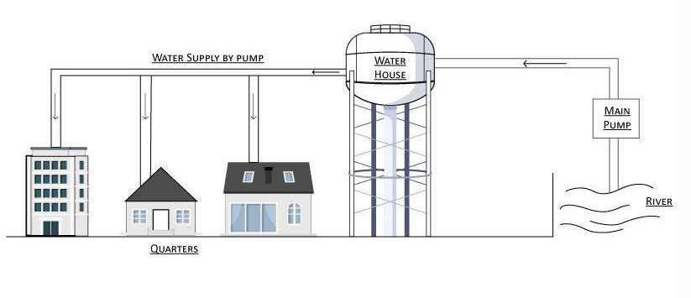
Green Shipbuilding
Less carbon emission in maritime industry to meet SDG targets in order to get open up new markets and Freelance on new projects.
Reduce, reuse, recycle
a specific profile sharing system
A central housing system
Lake of appropriate waste bins
Usage of plastic cups
Figure: Improved Pumping System

Slide 19

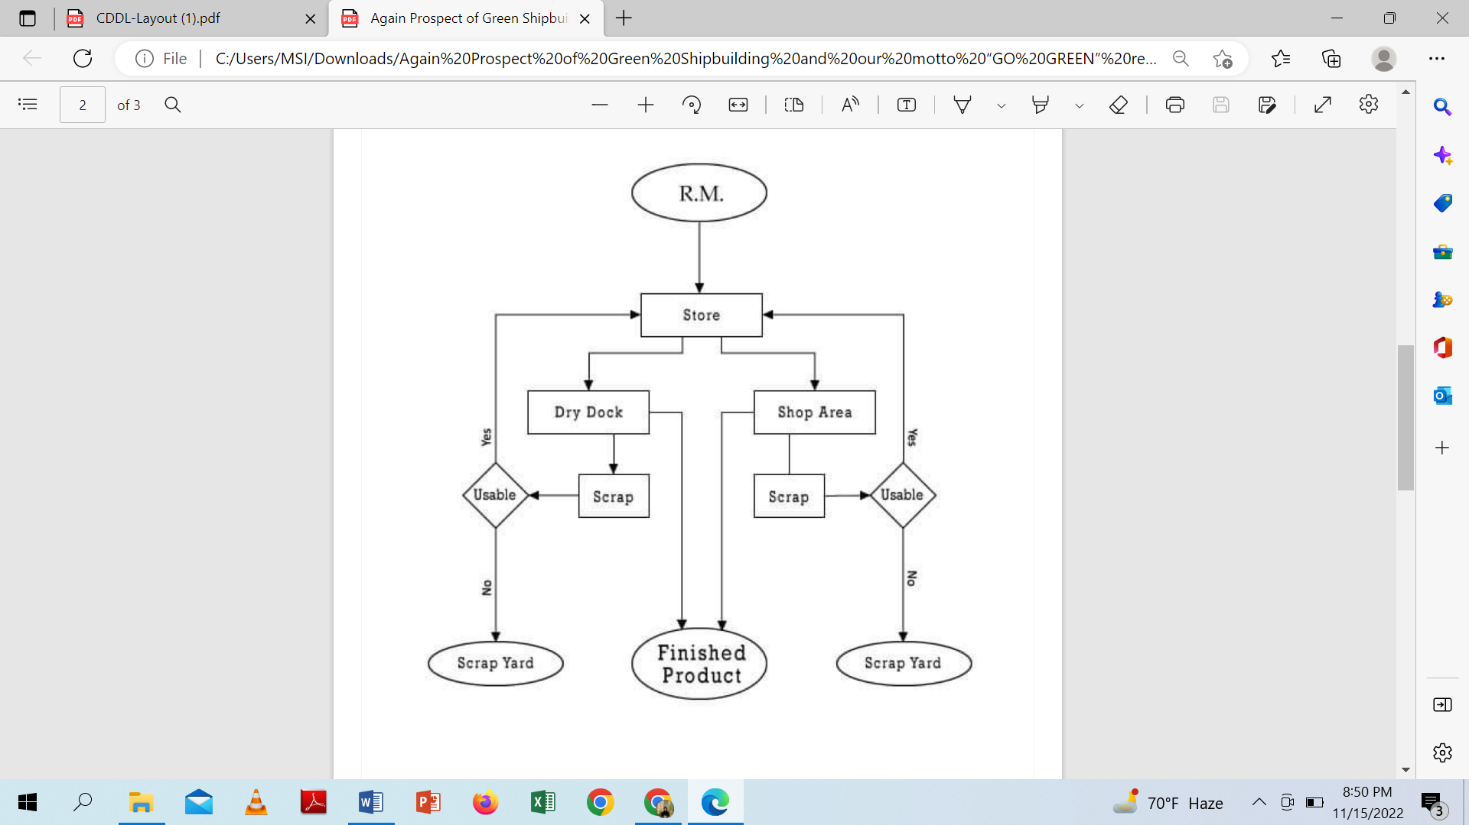
Reusing the materials available
in the very best manner
Figure : Flow chart of recycling

Slide 20
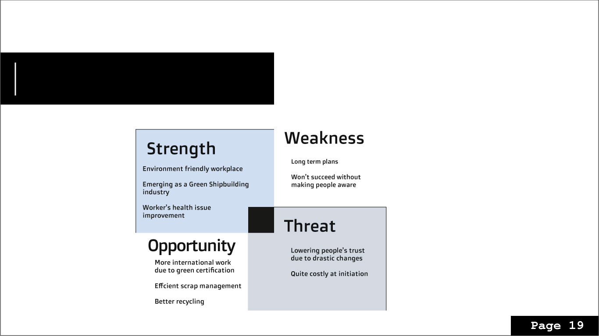
SWOT Analysis

Slide 21
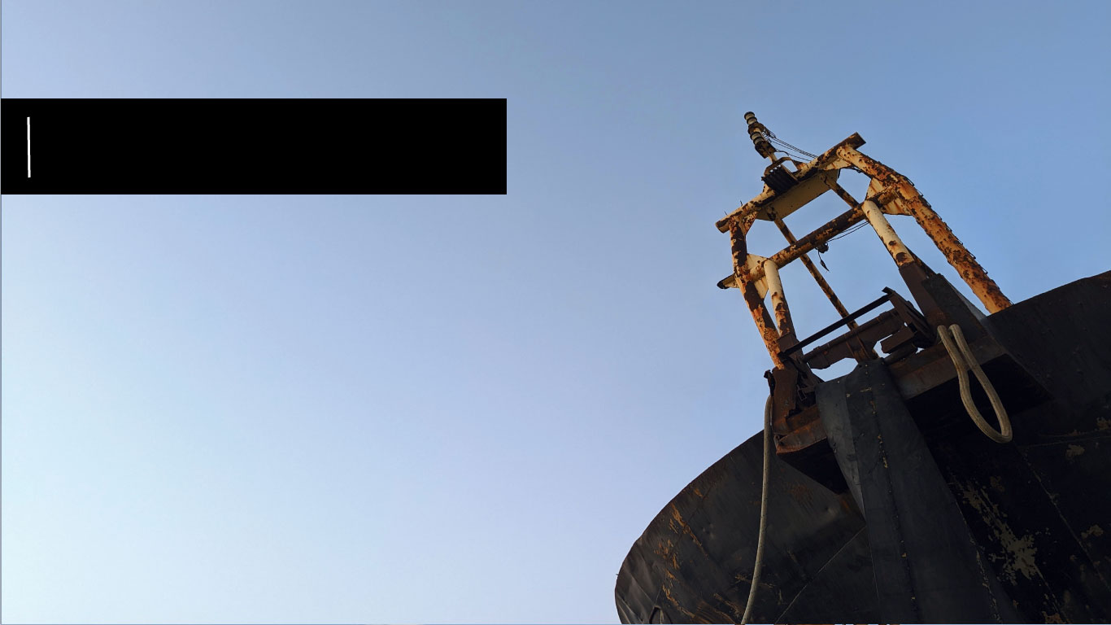
Conclusion
The world has become an unhealthier place to live in as a result of increased pollution levels. And our way of moving towards that goal is by taking CDDL along the way to green shipbuilding and maintain International Standars for safety and all other aspects. We tried to find out the best possible solution keeping in mind the profit of the organization, while keeping in mind the feasibility of the solution and its impact to the industry’s overall profit and economy

